Slide 1

Azure Data Factory
(ADF)

Slide 2
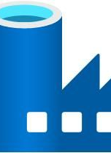
Intro to ADF & Architecture
Azure Data Factory (ADF) is a cloud-based service designed to help you move and transform data seamlessly. It allows you to create data pipelines that automate transferring data from various sources to destinations and perform necessary transformations like cleaning or combining data. ADF makes it easy to schedule these tasks, ensuring they run at specific times, and provides tools to monitor and manage the workflows, ensuring smooth and reliable data integration and processing.

Slide 3
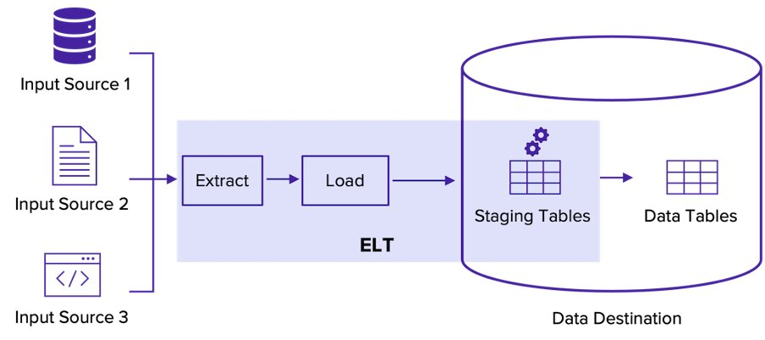
ELT (Extract, Load, Transform)
ELT (Extract, Load, Transform) is a data integration process where data is extracted from various sources, loaded into a central repository like a data lake or data warehouse, and finally transformed as needed. This approach leverages the processing power of the central repository to perform complex transformations, making it suitable for handling large volumes of data and complex transformations.

Slide 4
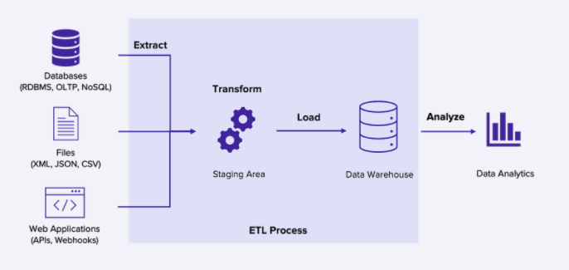
ETL (Extract, Transform, Load)
ETL (Extract, Transform, Load) is a data integration process where data is first extracted from various sources, then transformed into a suitable format or structure, and finally loaded into a target database or data warehouse. This approach ensures that data is cleaned, transformed, and structured before it reaches the final destination, which is ideal for ensuring data quality and consistency.

Slide 5
(ADF) Components
Azure Data Factory (ADF) is a powerful cloud-based data integration service that helps automate data movement and transformation. Understanding its key components is essential to effectively leveraging its capabilities.

Slide 6
Activities
Activities represent the processing steps within a pipeline.
Data Movement: Copy Activity moves data between different data stores.
Data Transformation: Mapping Data Flow transforms data within ADF.
Control Activities: If Condition, For Each, which manages workflow control.

Slide 7
Datasets
Datasets represent data structures within the data stores.
Function: They define the schema of data within sources and destinations, acting as inputs and outputs for activities. Sets represent data structures within the data stores.

Slide 8
Linked Services
Linked Services define the connection information to data sources and destinations.
Function: They act like connection strings, specifying how ADF connects to and accesses data.

Slide 10
Integration Runtimes
Integration Runtimes provide the compute infrastructure for data movement and transformation.
Azure Integration Runtime: Handles cloud-based data movement and transformation.
Self-Hosted Integration Runtime: Enables data integration across private networks and on-premises data stores.
Azure-SSIS Integration Runtime: Runs SSIS packages in a managed environment.

Slide 11
